Slide 1
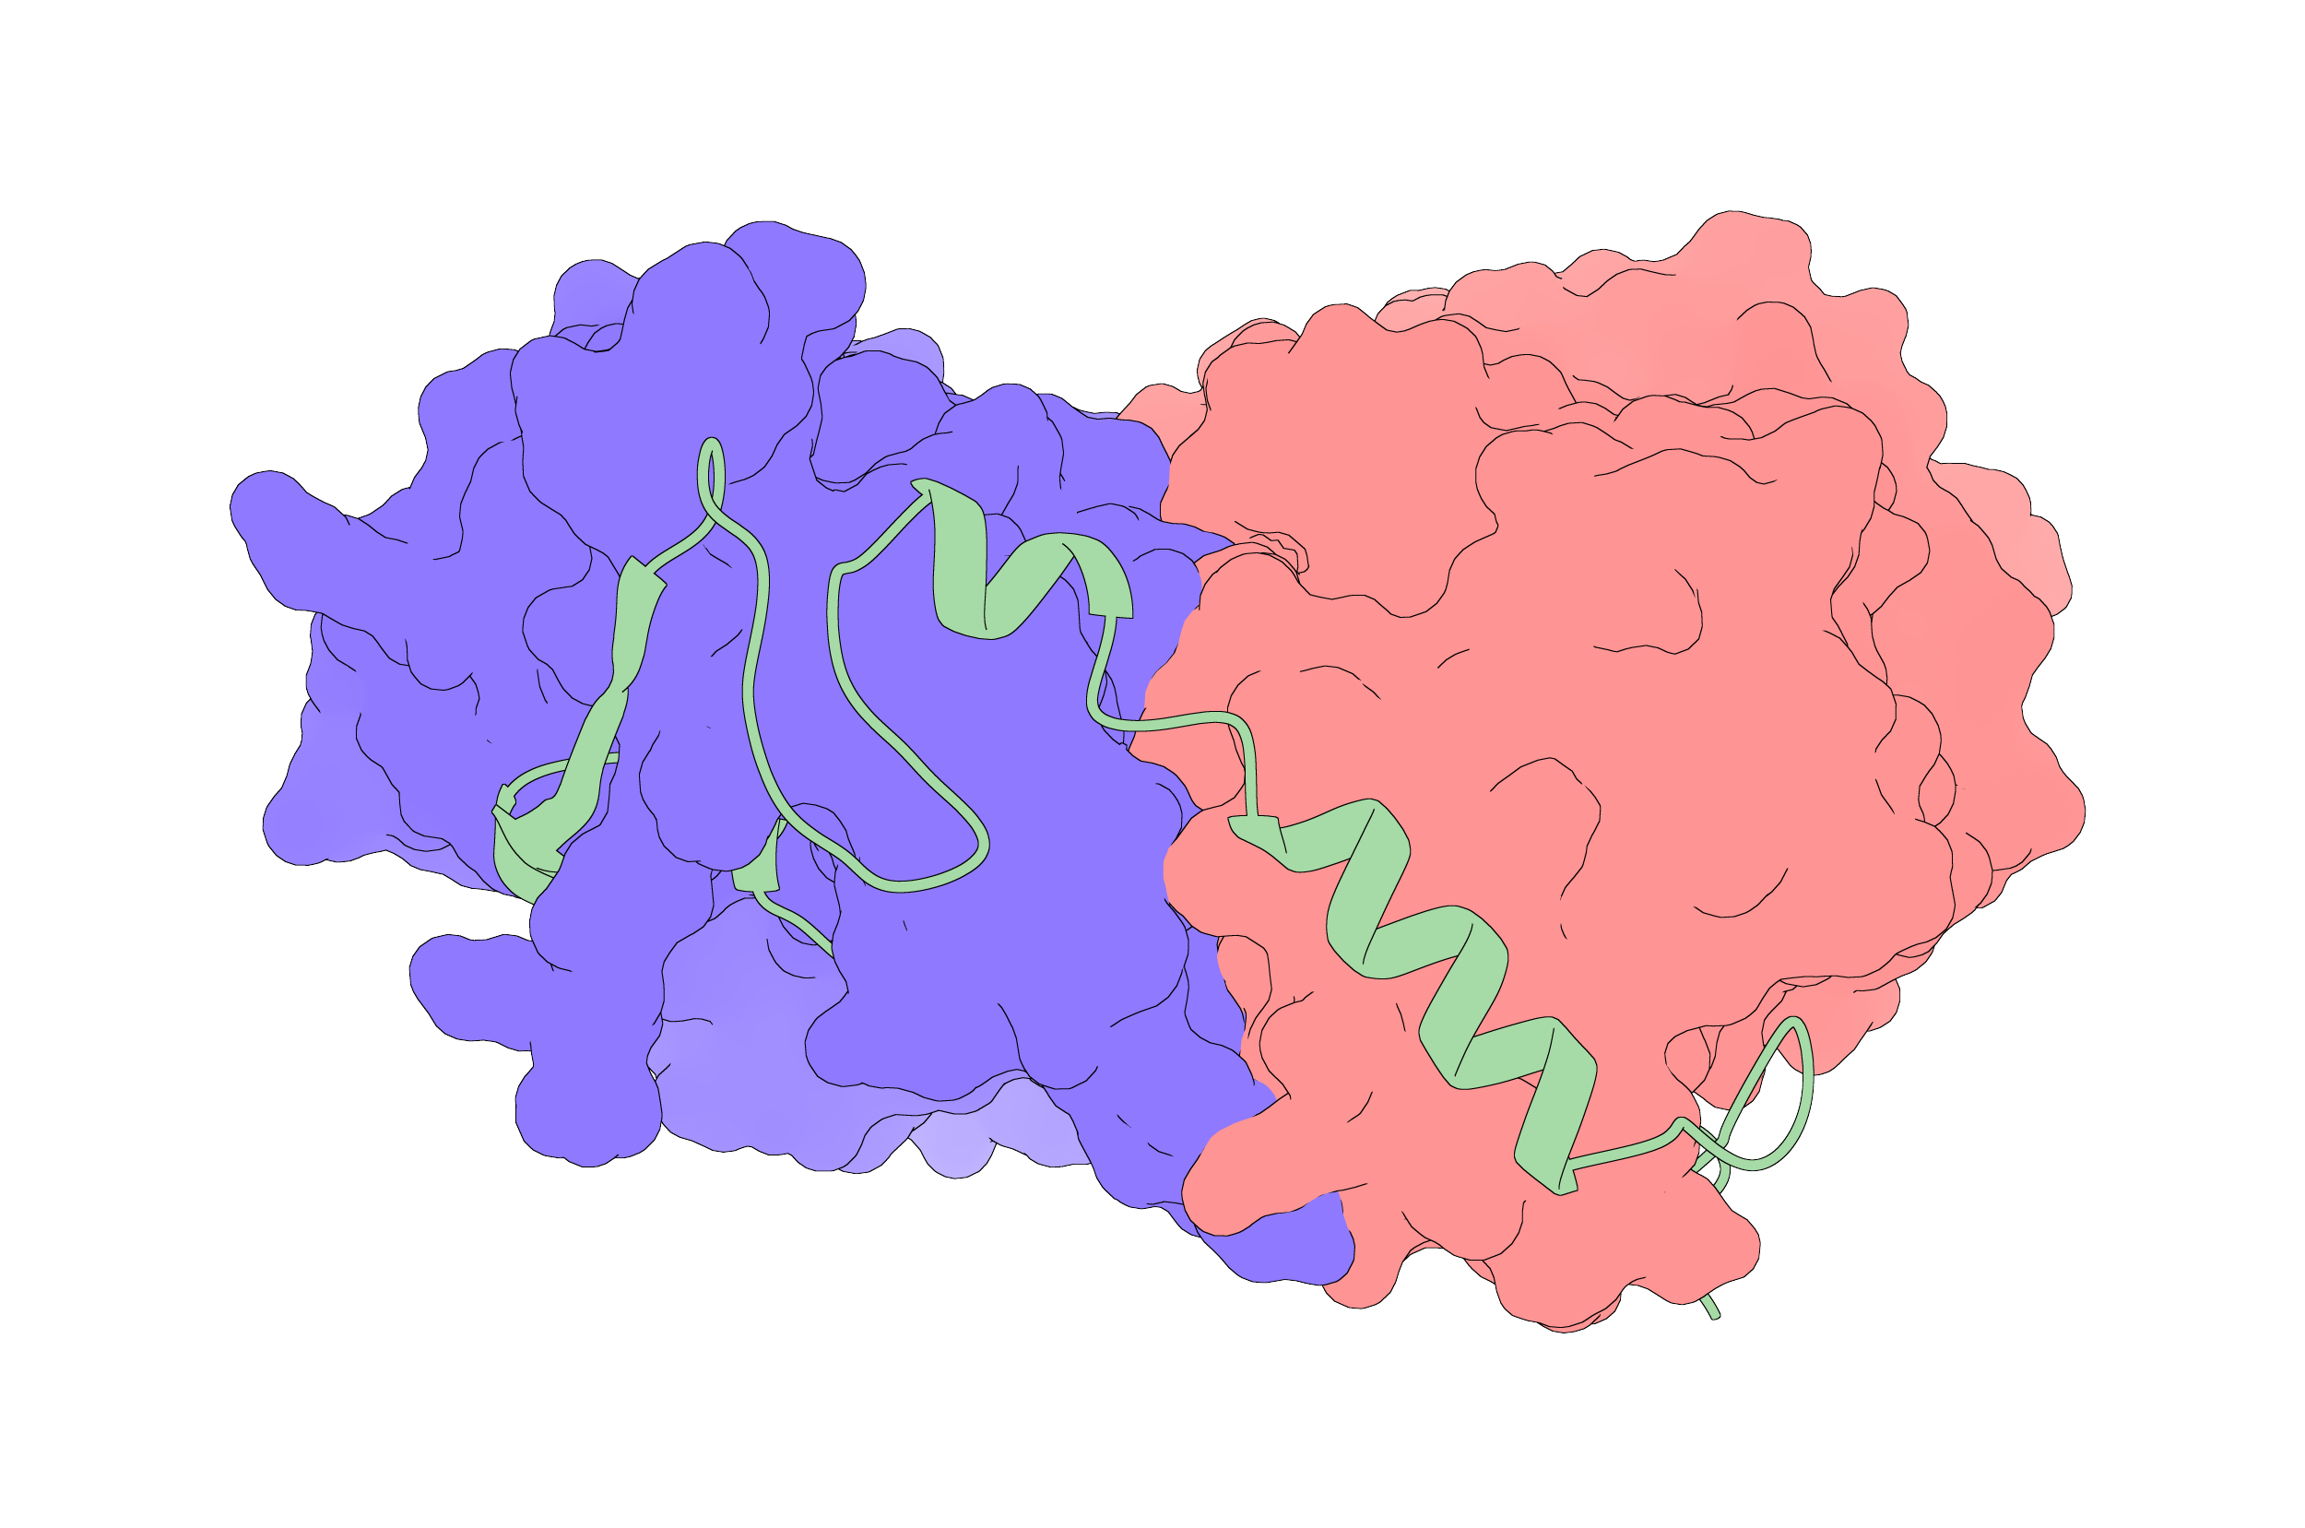


Linear Interacting Peptides (LIPs) Detection in Protein Sequences Based on Embedding Models
Supervisor
Damiano Piovesan
Master Candidate
Riccardo Carangelo
University of Padova
Academic year 2023-2024

Slide 2
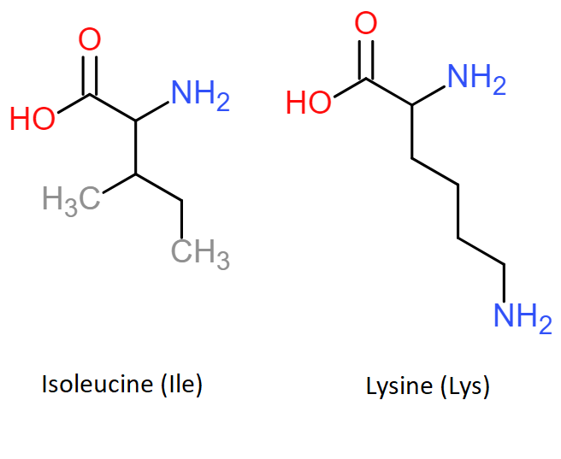
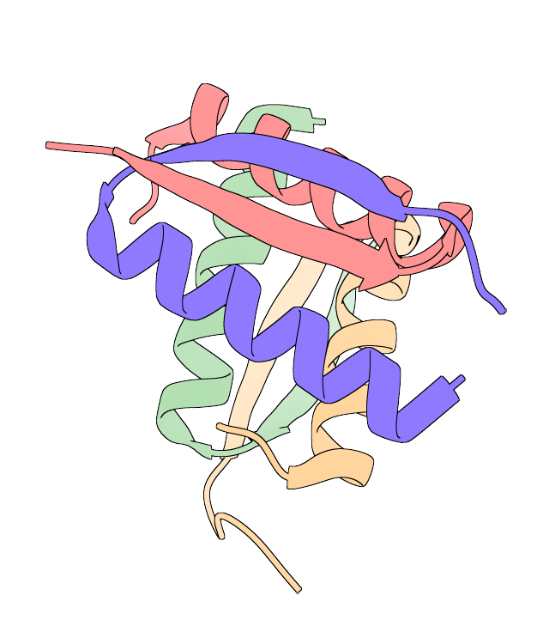
Proteins
Proteins are amino acid-based polymers, involved in most processes of life
Amino acids composition determines arrangement in space, which determines function
MAQNDSQEFAELWEKNLII…

Slide 3
Protein interactions
P27(KIP1)/CYCLIN A/CDK2 COMPLEX
Linear Interacting Peptide (LIP)
Proteins can interact with each other (through stable or unstable interactions)
This project focuses on linear interacting peptides (LIPs)
Target chains

Slide 4
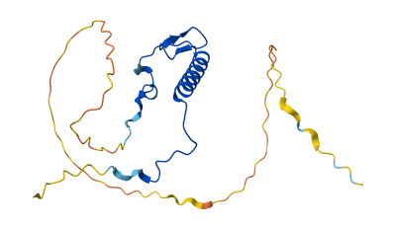

The idea of the project
Exploration and prediction of LIPs using several datasets and tools.
The input: protein amino acid sequences
The task: provide a probability for each amino acid position
The innovation of the method lies in the fact that LIPs are predicted starting from sequences and using embeddings
MSNVRVSNGSPSLERMDARQAEHPKPSACRNLFGPVDHEELTRDLEKHCRDMEEASQRKWNFDFQNHKPLEGKYEWQEVEKGSLPEFYYRPPRPPKGACKVPAQESQDVSGSRPAAPLIGAPANSEDTHLVDPKTDPSDSQTGLAEQCAGIRKRPATDDSSTQNKRANRTEENVSDGSPNAGSVEQTPKKPGLRRRQT
MSNVRVSNGSPSLERMDARQAEHPKPSACRNLFGPVDHEELTRDLEKHCRDMEEASQRKWNFDFQNHKPLEGKYEWQEVEKGSLPEFYYRPPRPPKGACKVPAQESQDVSGSRPAAPLIGAPANSEDTHLVDPKTDPSDSQTGLAEQCAGIRKRPATDDSSTQNKRANRTEENVSDGSPNAGSVEQTPKKPGLRRRQT

Slide 5
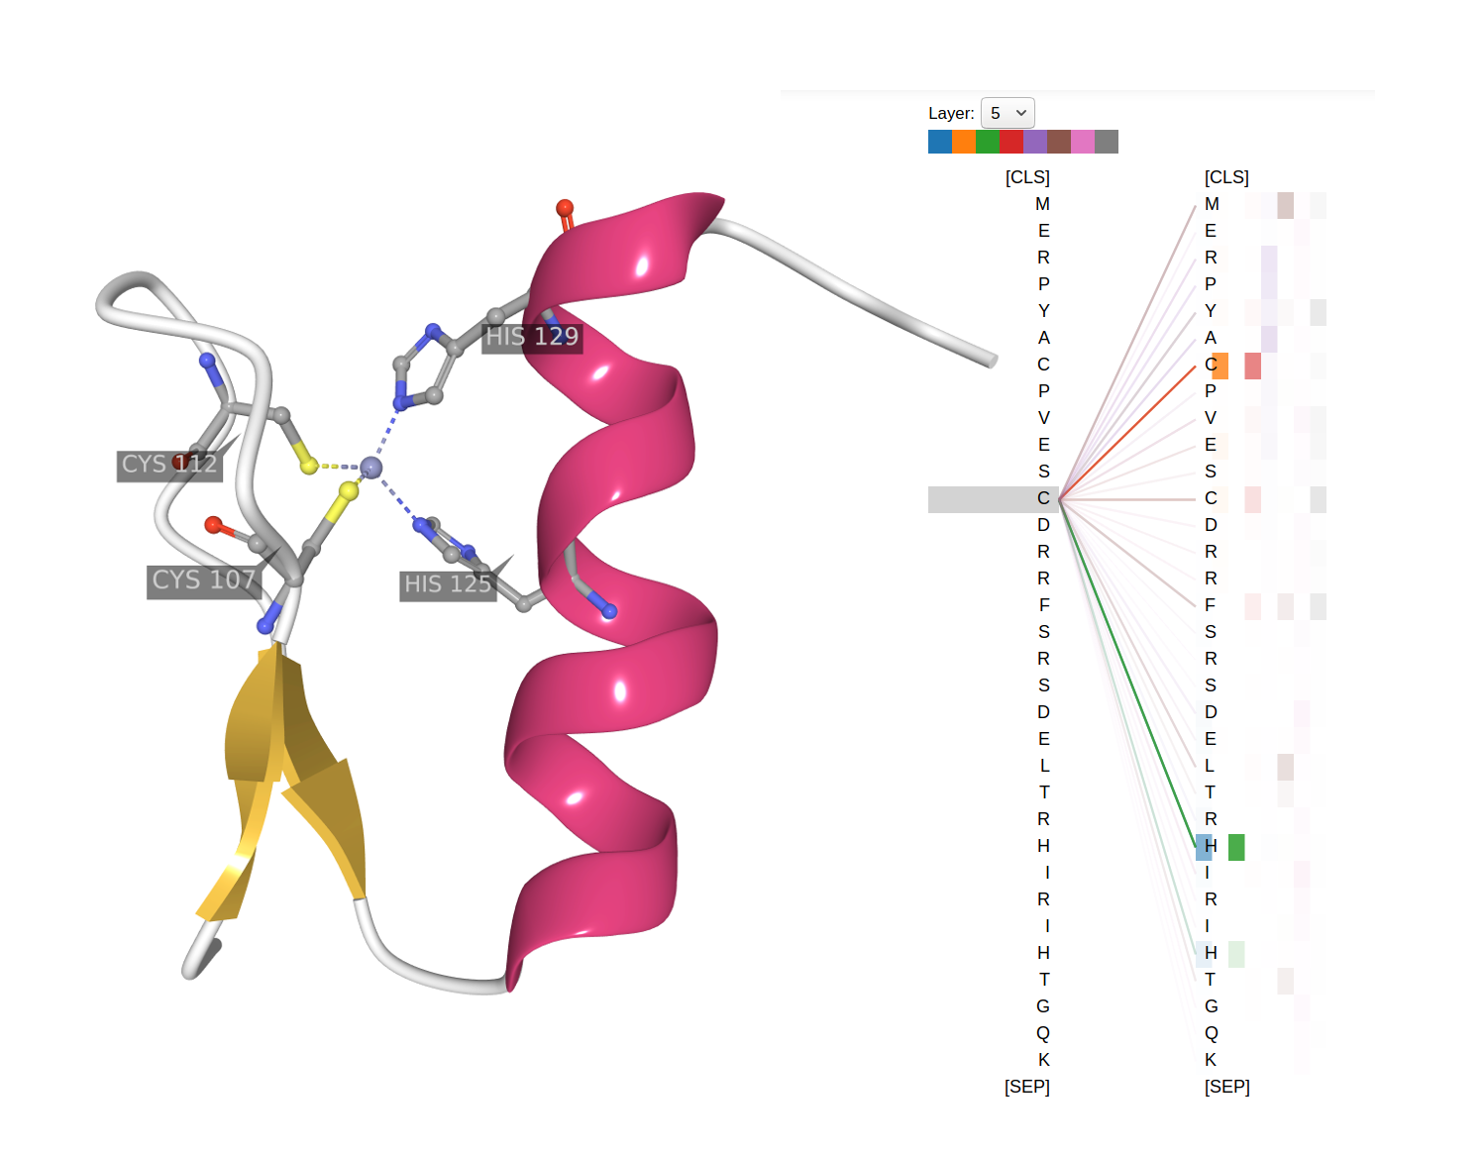
The idea of the project
Features generated using embedding representations calculated with ProtT5 (a Protein Language Model) for each amino acid position
Labels for each amino acid were calculated using FLIPPER, a LIP predictor based on several structural characteristics

Slide 6
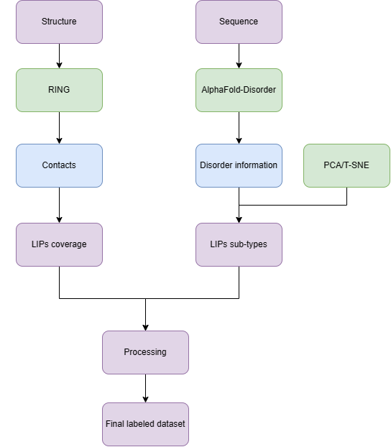
Training set preparation
The dataset was explored and processed before building the right CNN model
Two steps of exploration:
Analysis of the interactions in LIP regions
Number of LIPs in disordered regions

Slide 7
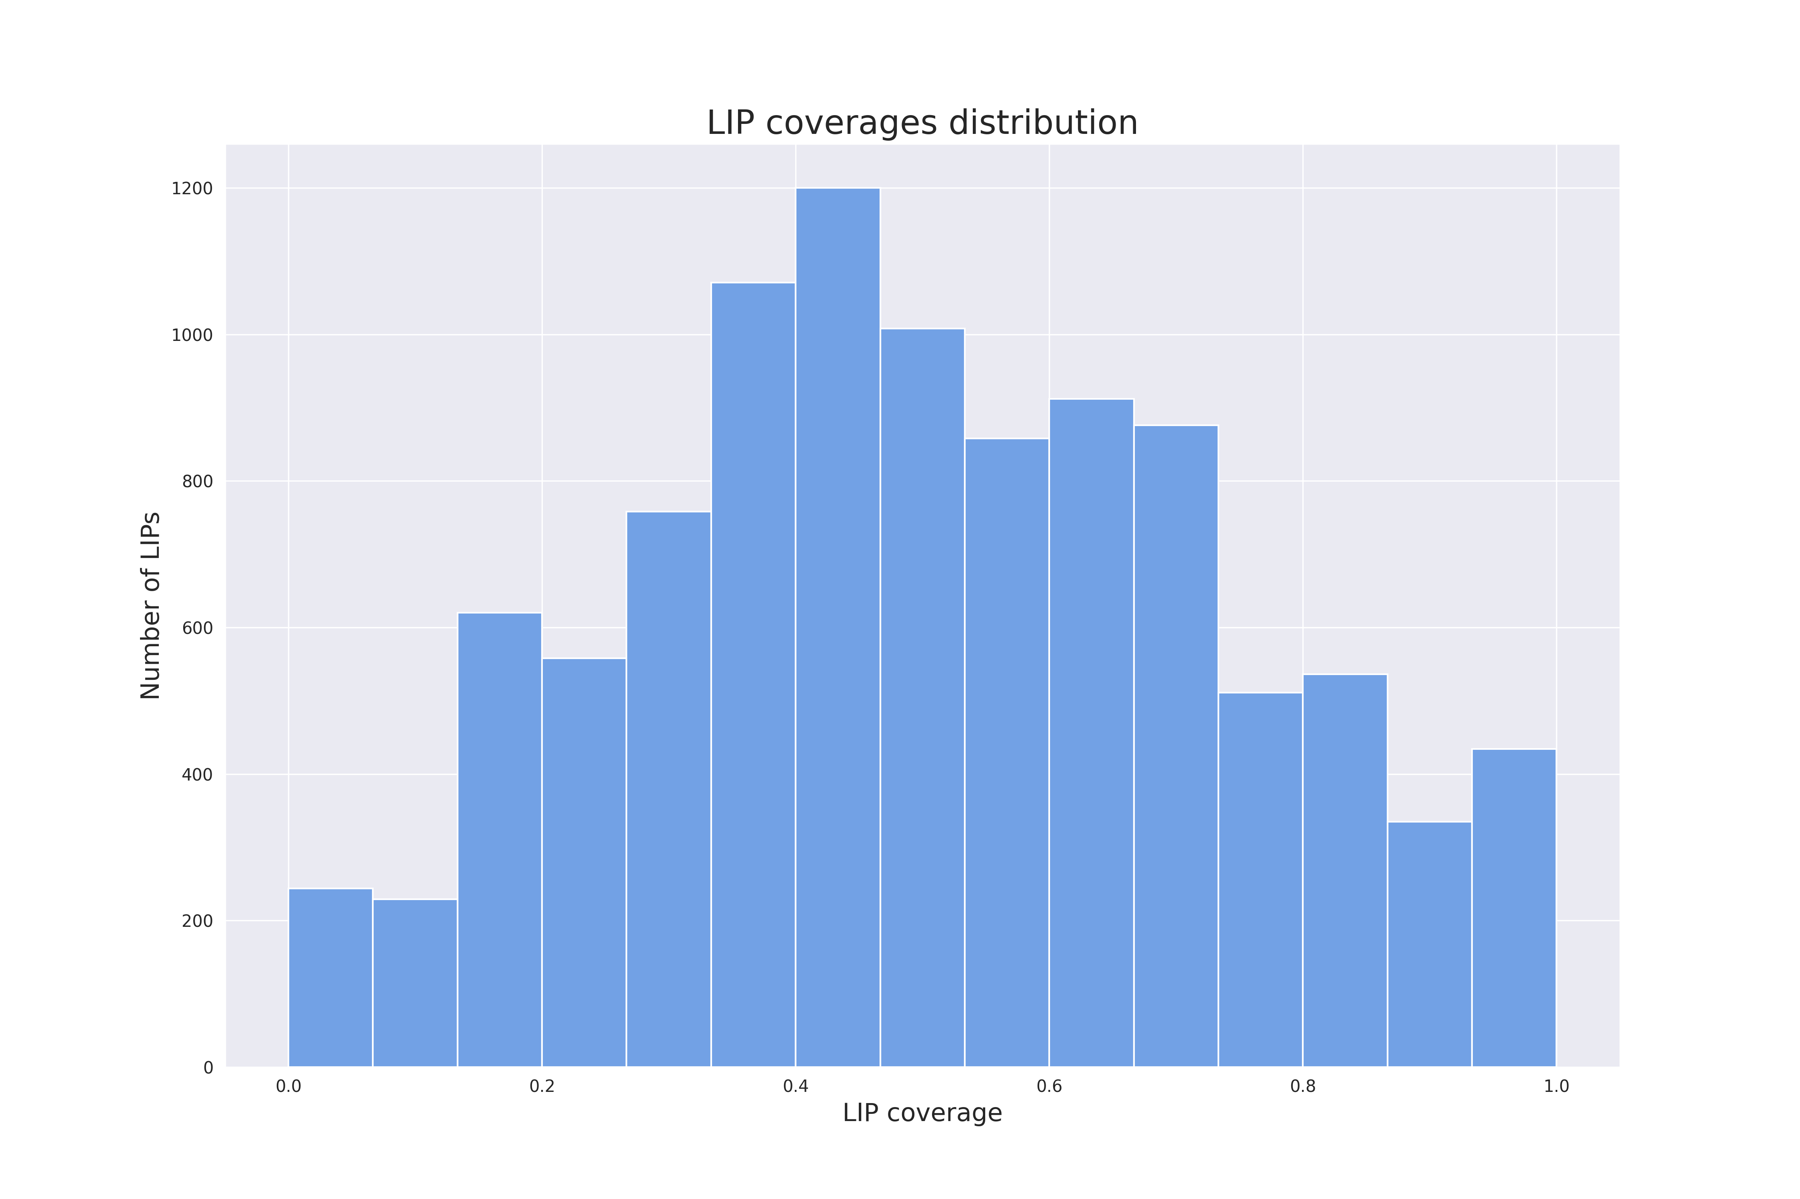
Training set preparation
Two steps of exploration
First step
How many amino acids in LIP regions establish interactions?
Some low coverage sequences were discarded

Slide 8
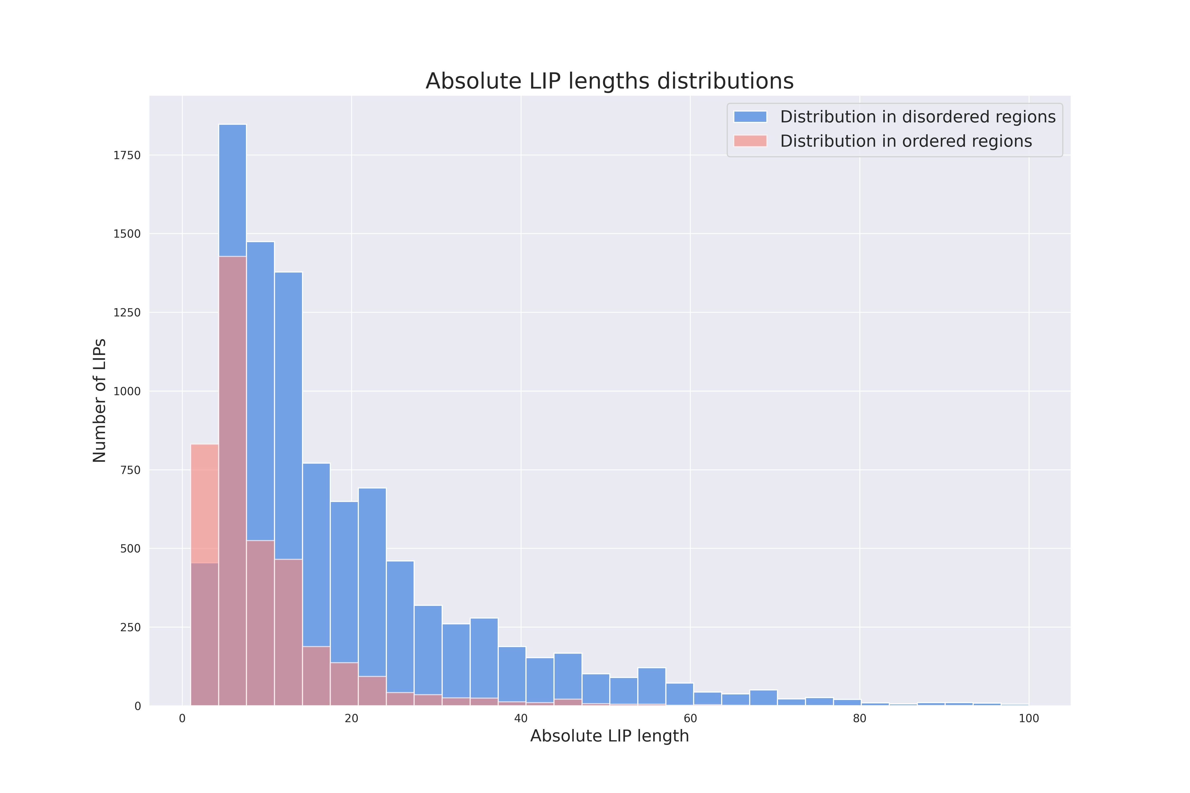
Training set preparation
Two steps of exploration
Second step
How many LIP regions are disordered?
An interesting gap in average lengths was found
Ordered LIPs avg. length of 9 AAs
Disordered LIPs avg. length of 19 AAs

Slide 9
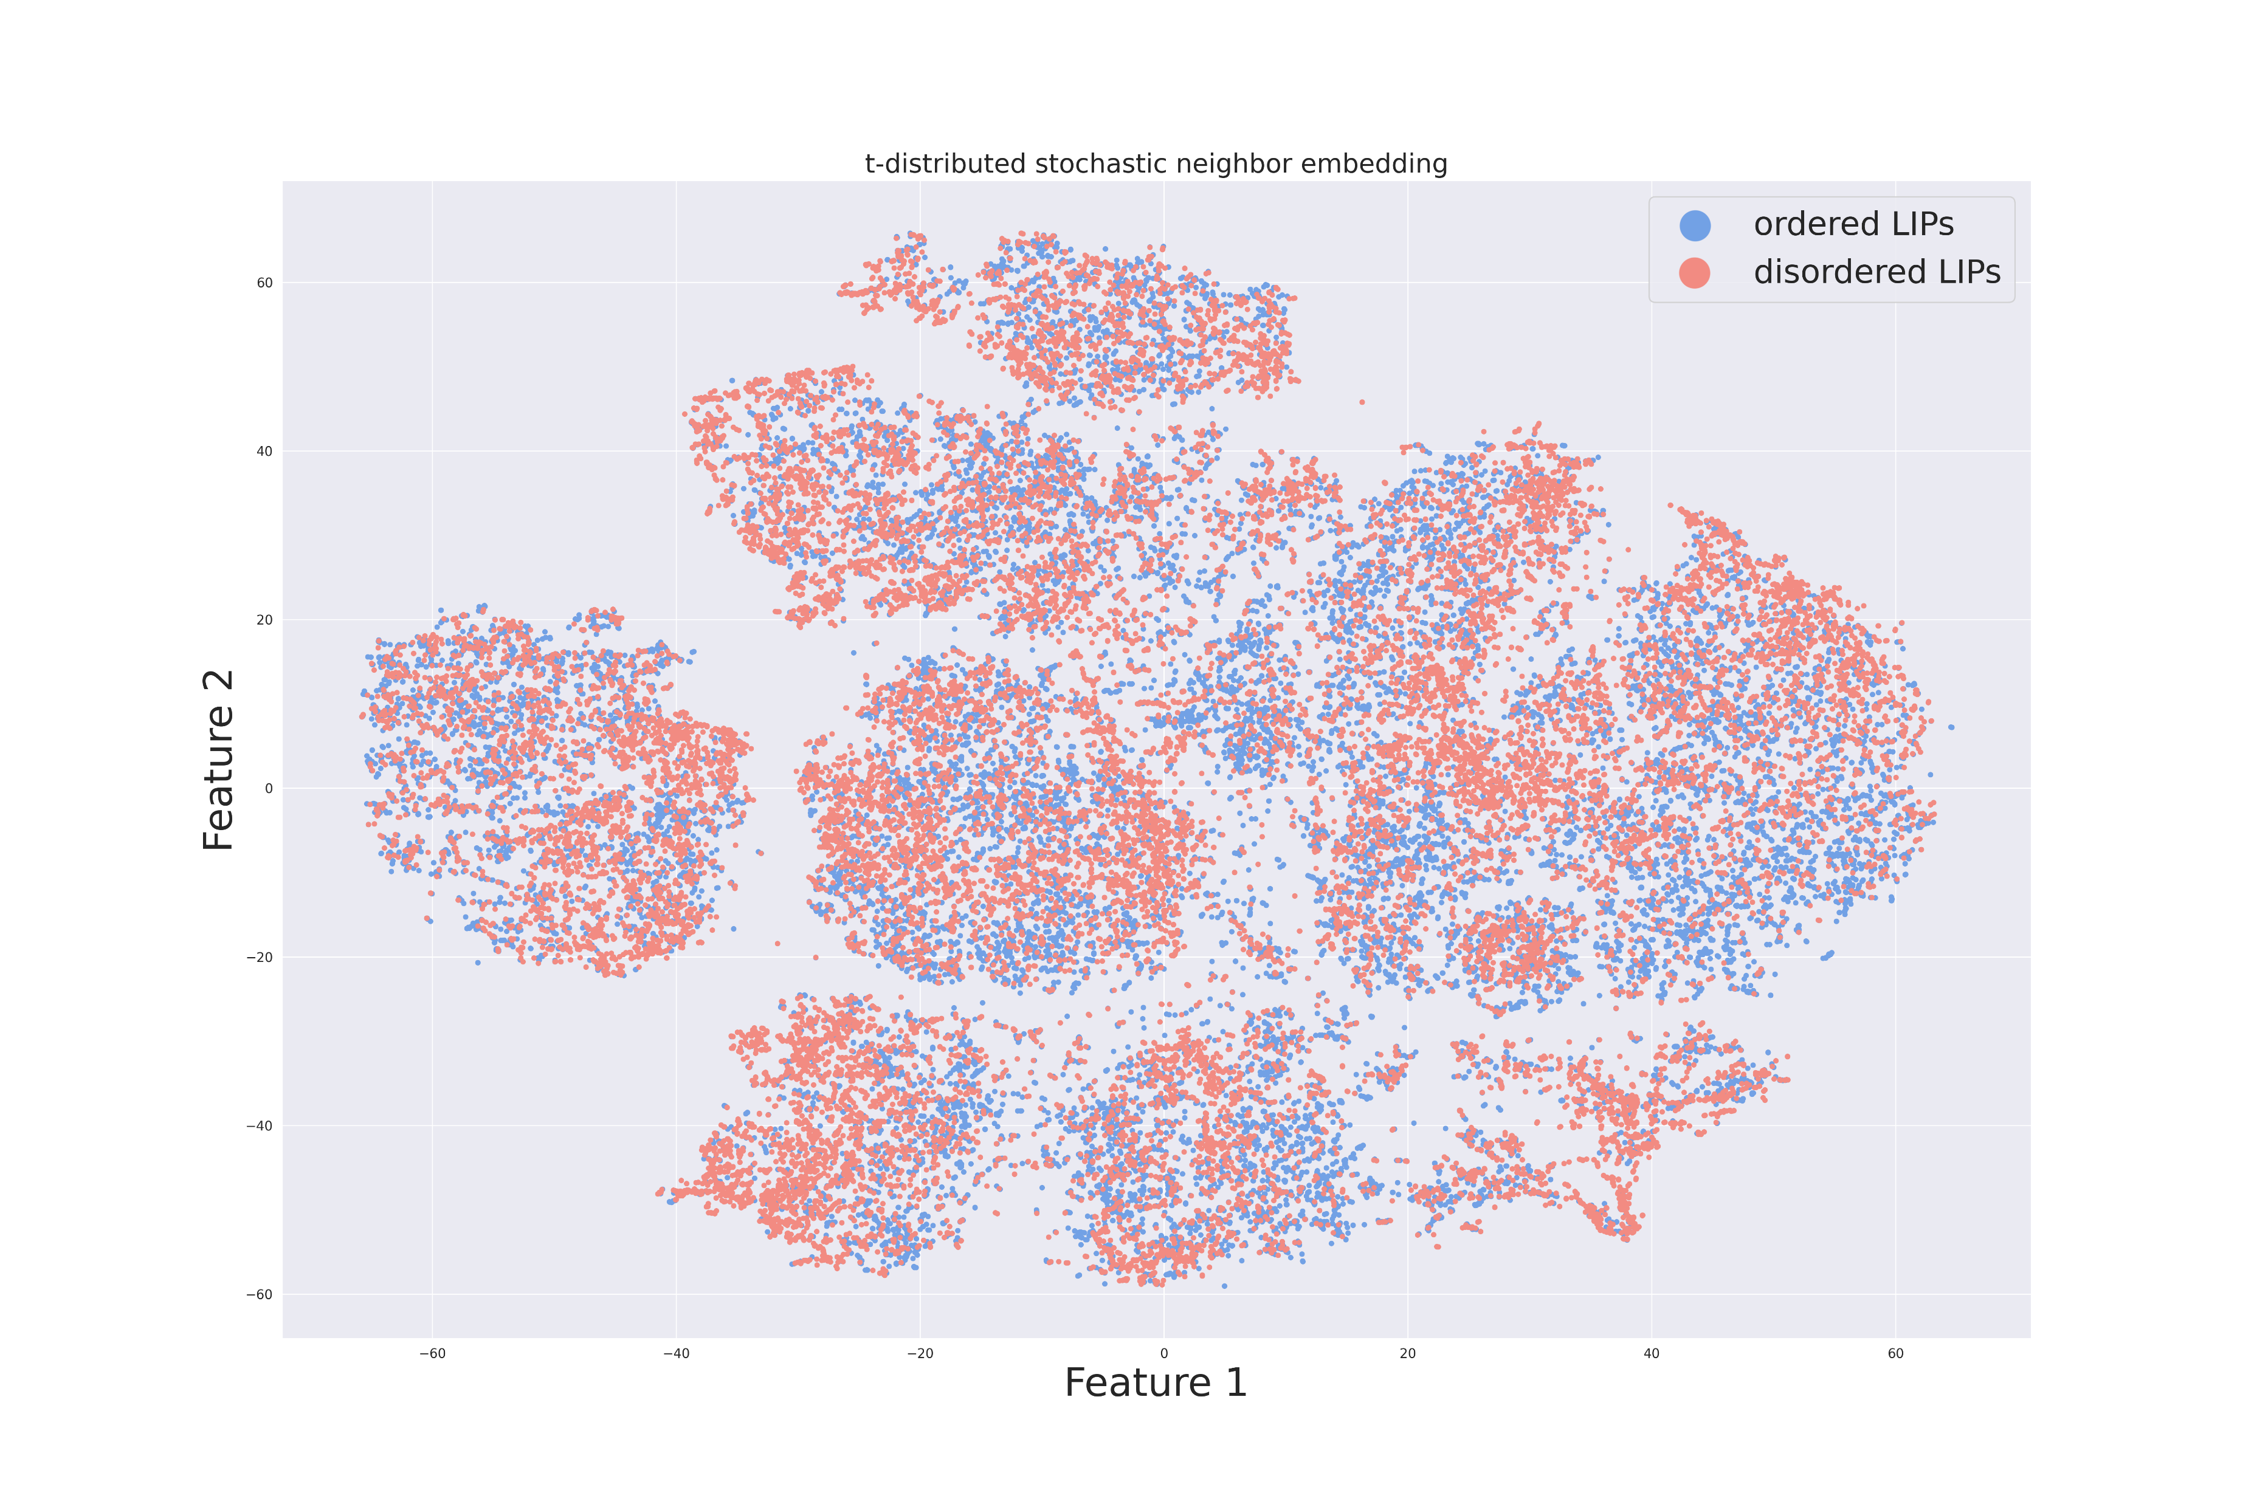
Training set preparation
Two steps of exploration
Second step
Separation is interesting (silhouette score of 0.0041)
The two groups can be considered separately

Slide 10
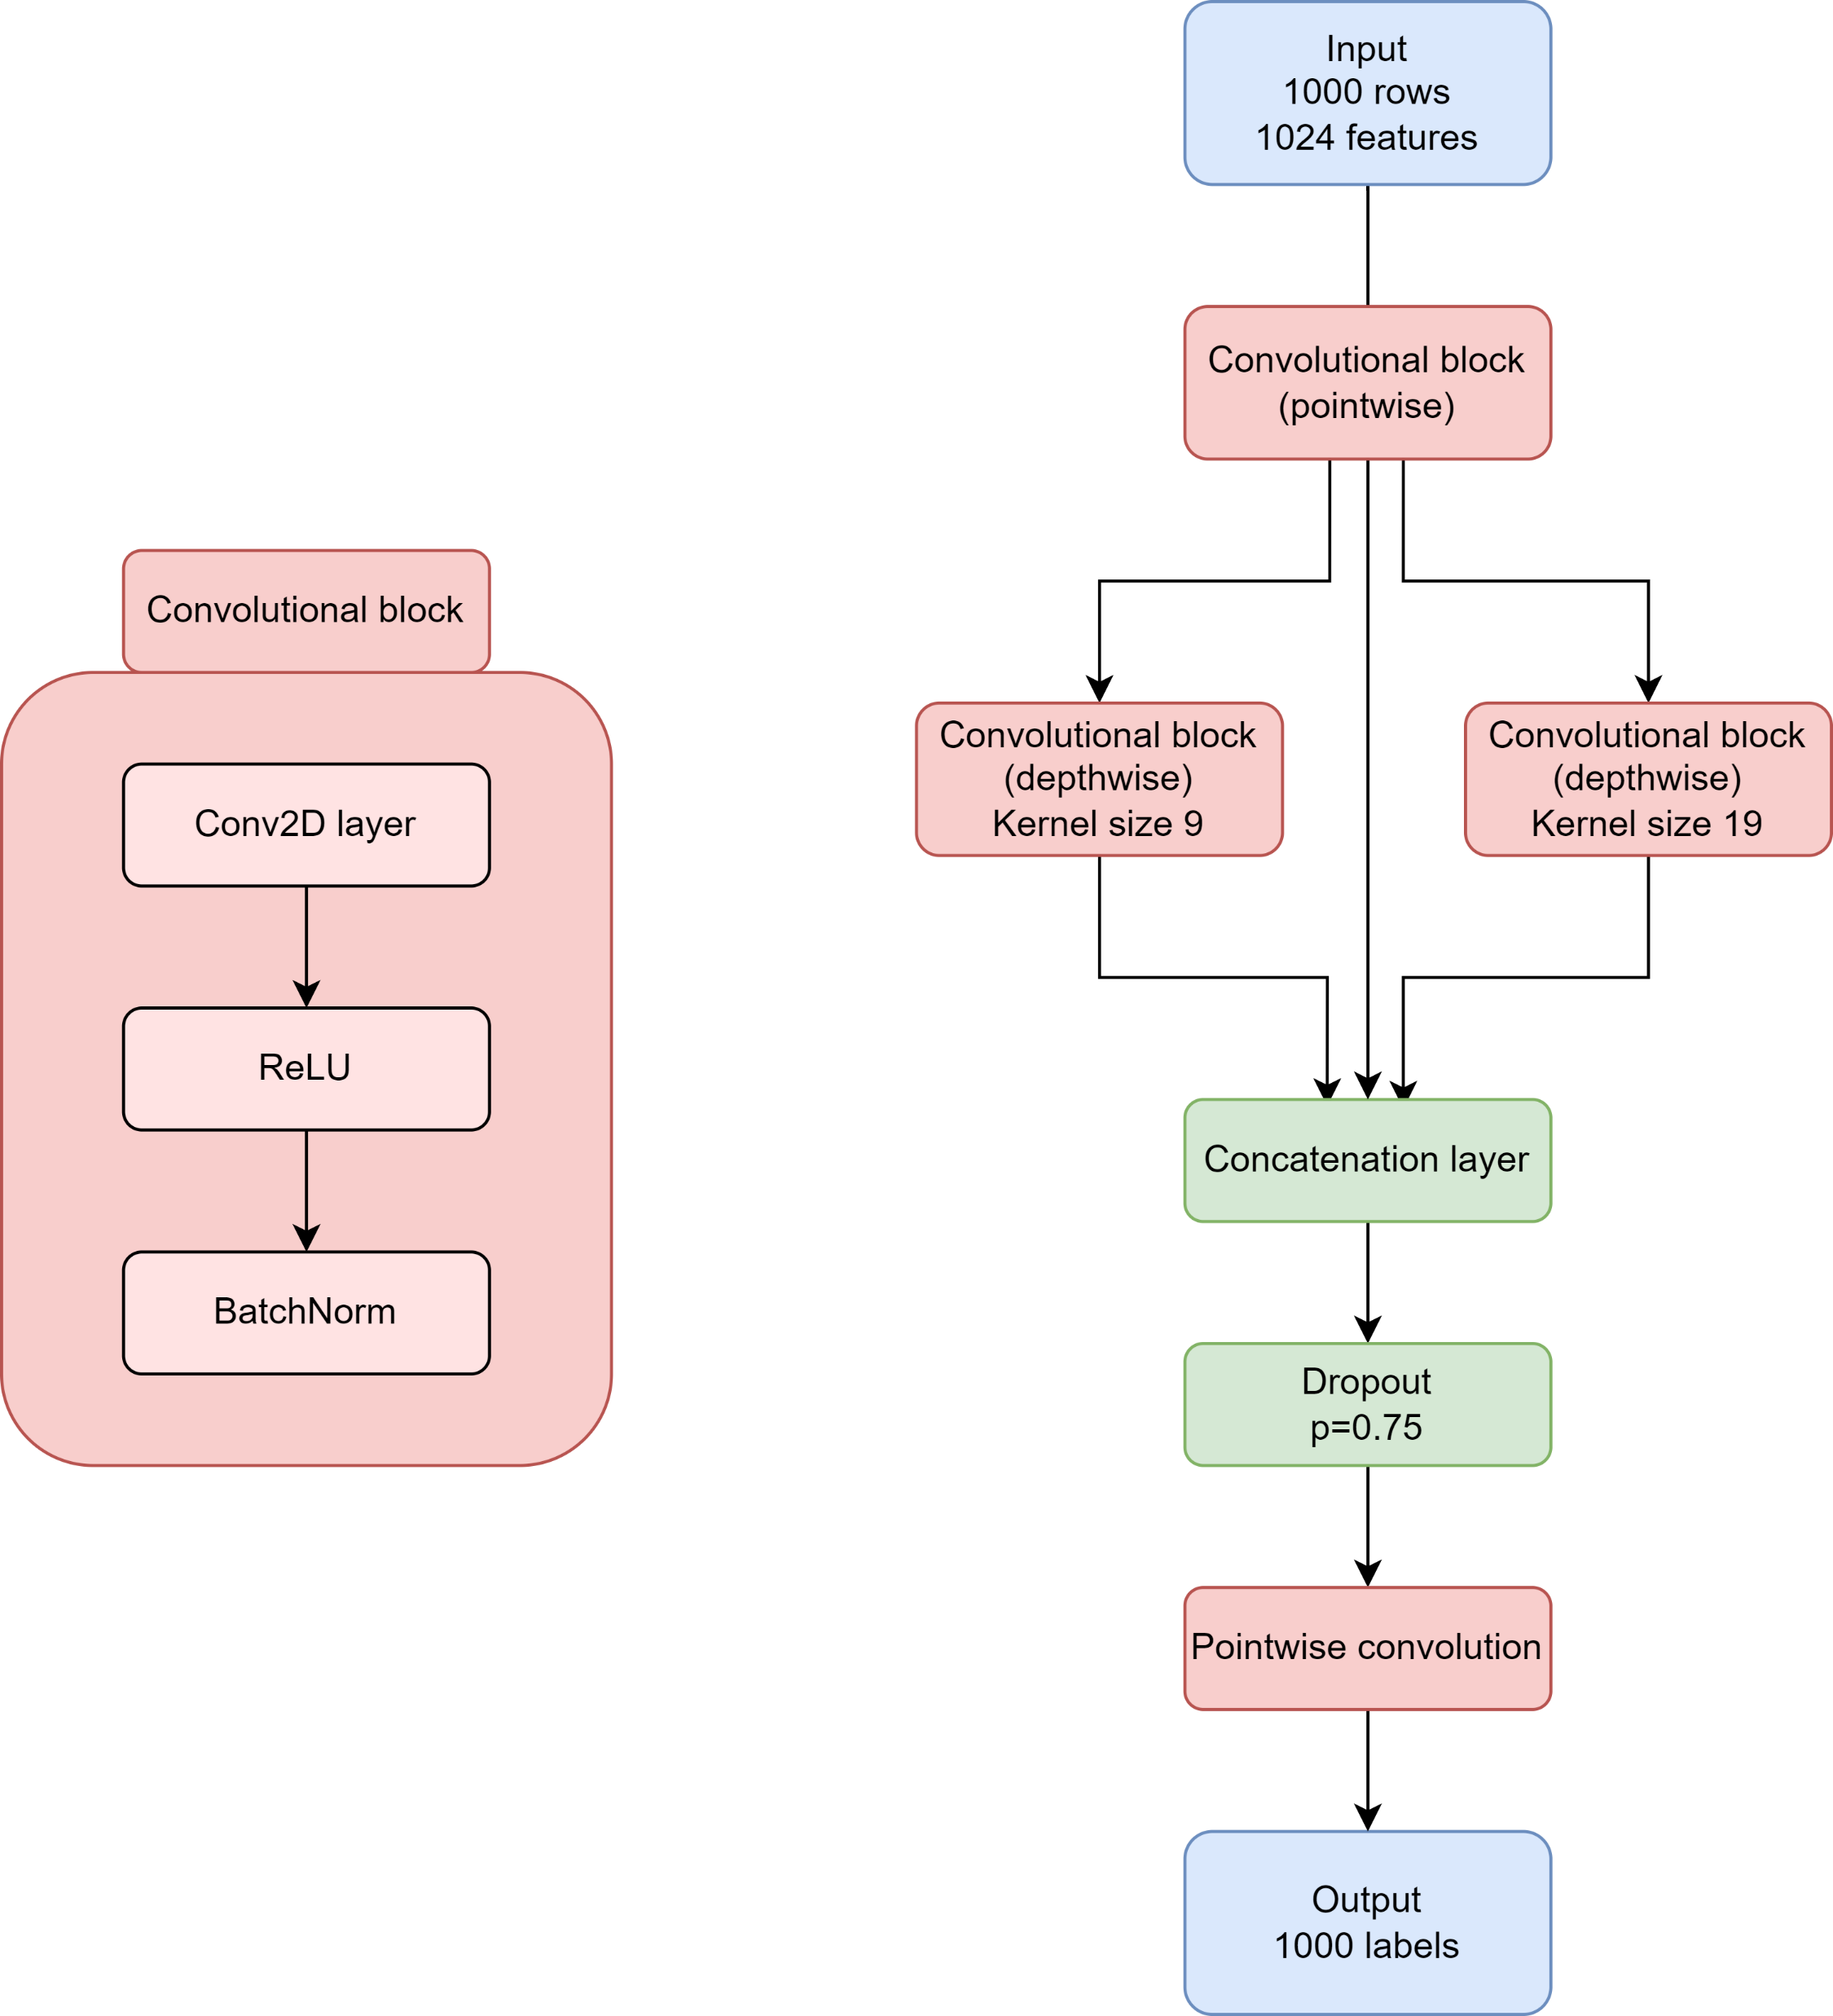
The CNN model
Model outline:
Pointwise convolution
Depthwise convolution
Several regularization tools

Slide 11
Training specifics
First grid-search
Hybrid regularization grid-search for
The right optimizer (between Adam and AdamW)
The final dropout value
The final learning rate value
The final weight decay value
Batch normalization

Slide 12
Training specifics
Second grid-search
Hyperparameters grid-search for
Batch size of the input
Output channels for the first pointwise convolutional block

Slide 13
Training specifics
Optimizer: AdamW (with learning rate of 0.00001 and weight decay of 0.001)
Loss function: binary cross-entropy
Validation strategy: 5-fold stratified cross-validation
Early stopping for delta-loss less than 0.01 with a 5 epochs patience

Slide 14
Training specifics
Dataset balancing
Random undersampling based on LIP-poor sequences
PyTorch built-in weight balancement

Slide 15
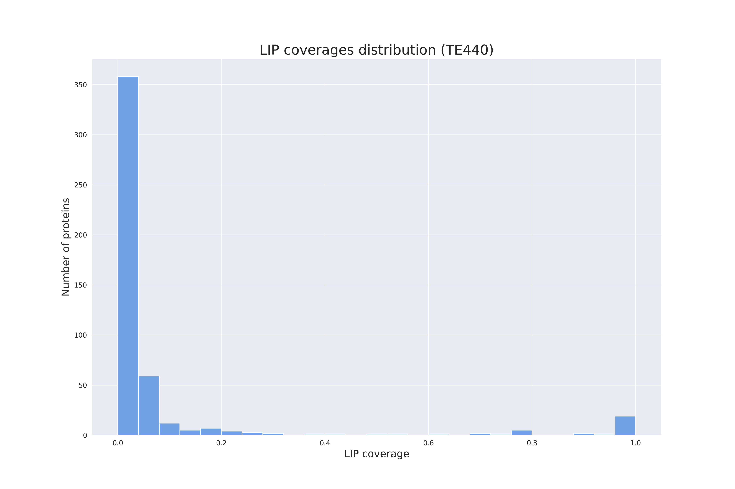
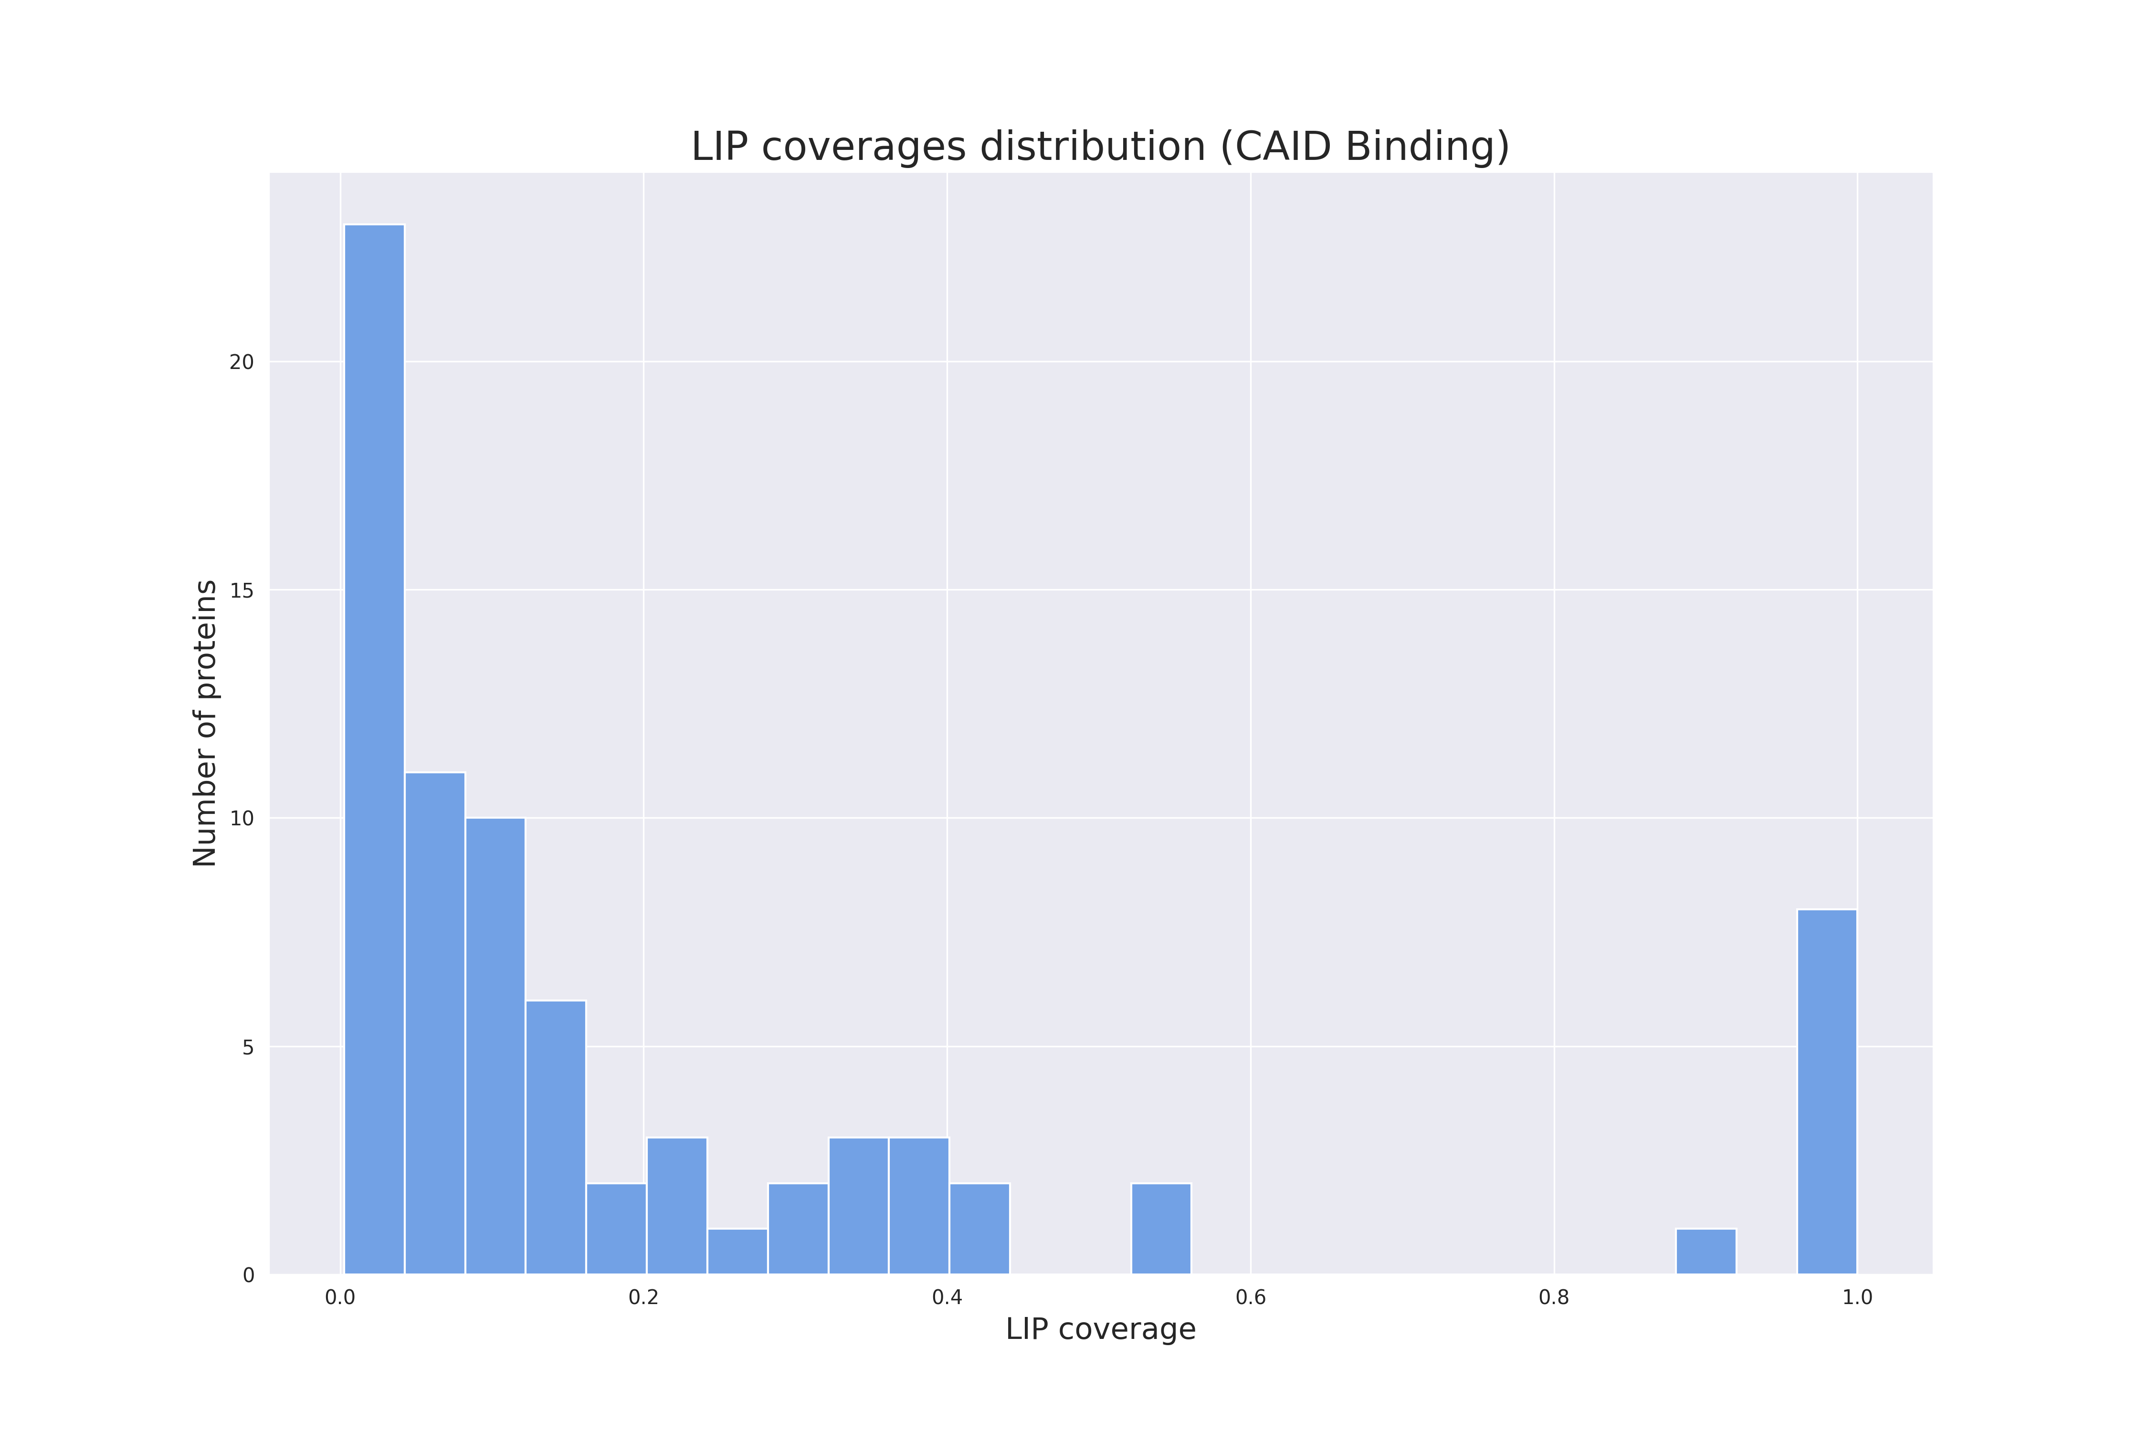
The test sets
Two datasets were used for testing the model:
- TE440 dataset (LIP-specific task)
- CAID Binding dataset (binding in disorder regions task)

Slide 16
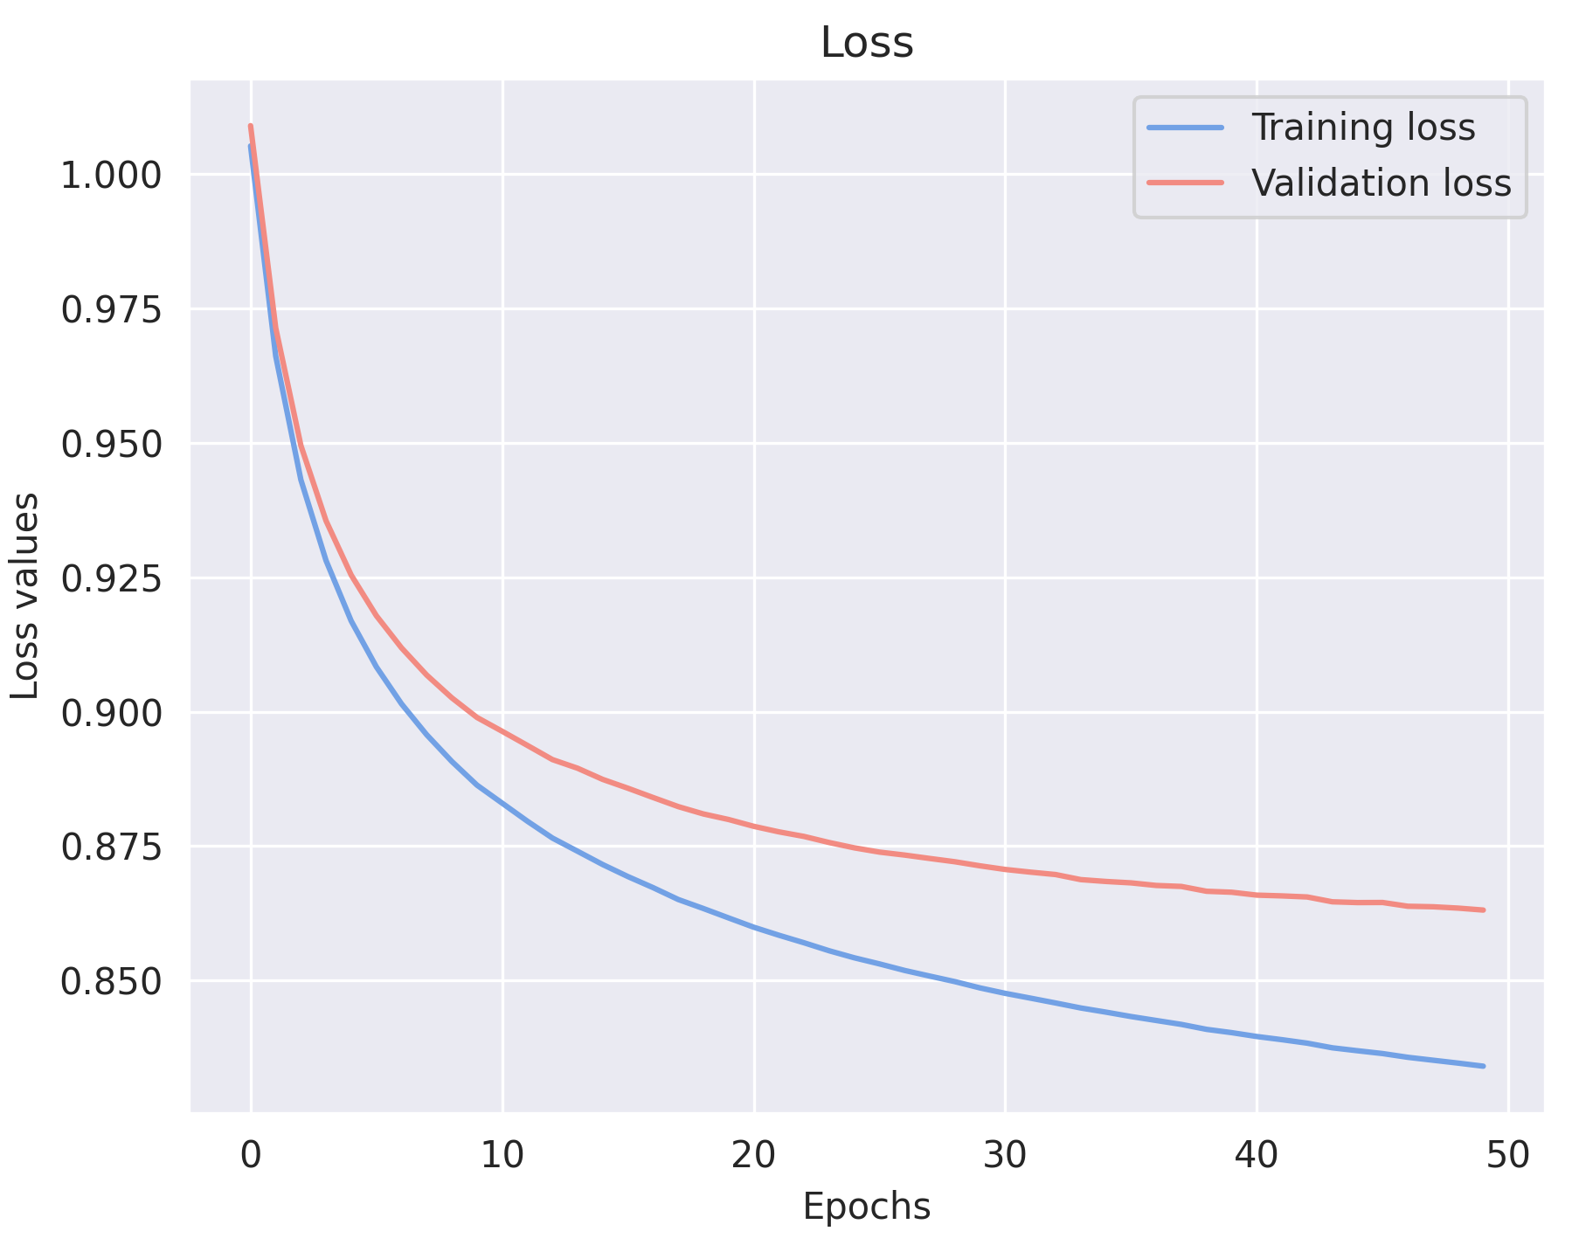
Results
Loss is stable and converge
Global results are good on the training set
Training scores
Precision score | 0.7790
Recall score | 0.8846
F1-score | 0.8221
Loss | 0.8334

Slide 17
Results
Validation sets show also good results
Test sets highlight some prediction problem
 | Validation set | TE440 | CAID Binding
Precision score | 0.7588 | 0.5783 | 0.5838
Recall score | 0.8729 | 0.6024 | 0.5777
F1-score | 0.8038 | 0.5882 | 0.5805
ROC-AUC score |  | 0.7392 | 0.6295
PR-AUC score |  | 0.154 | 0.2259

Slide 18
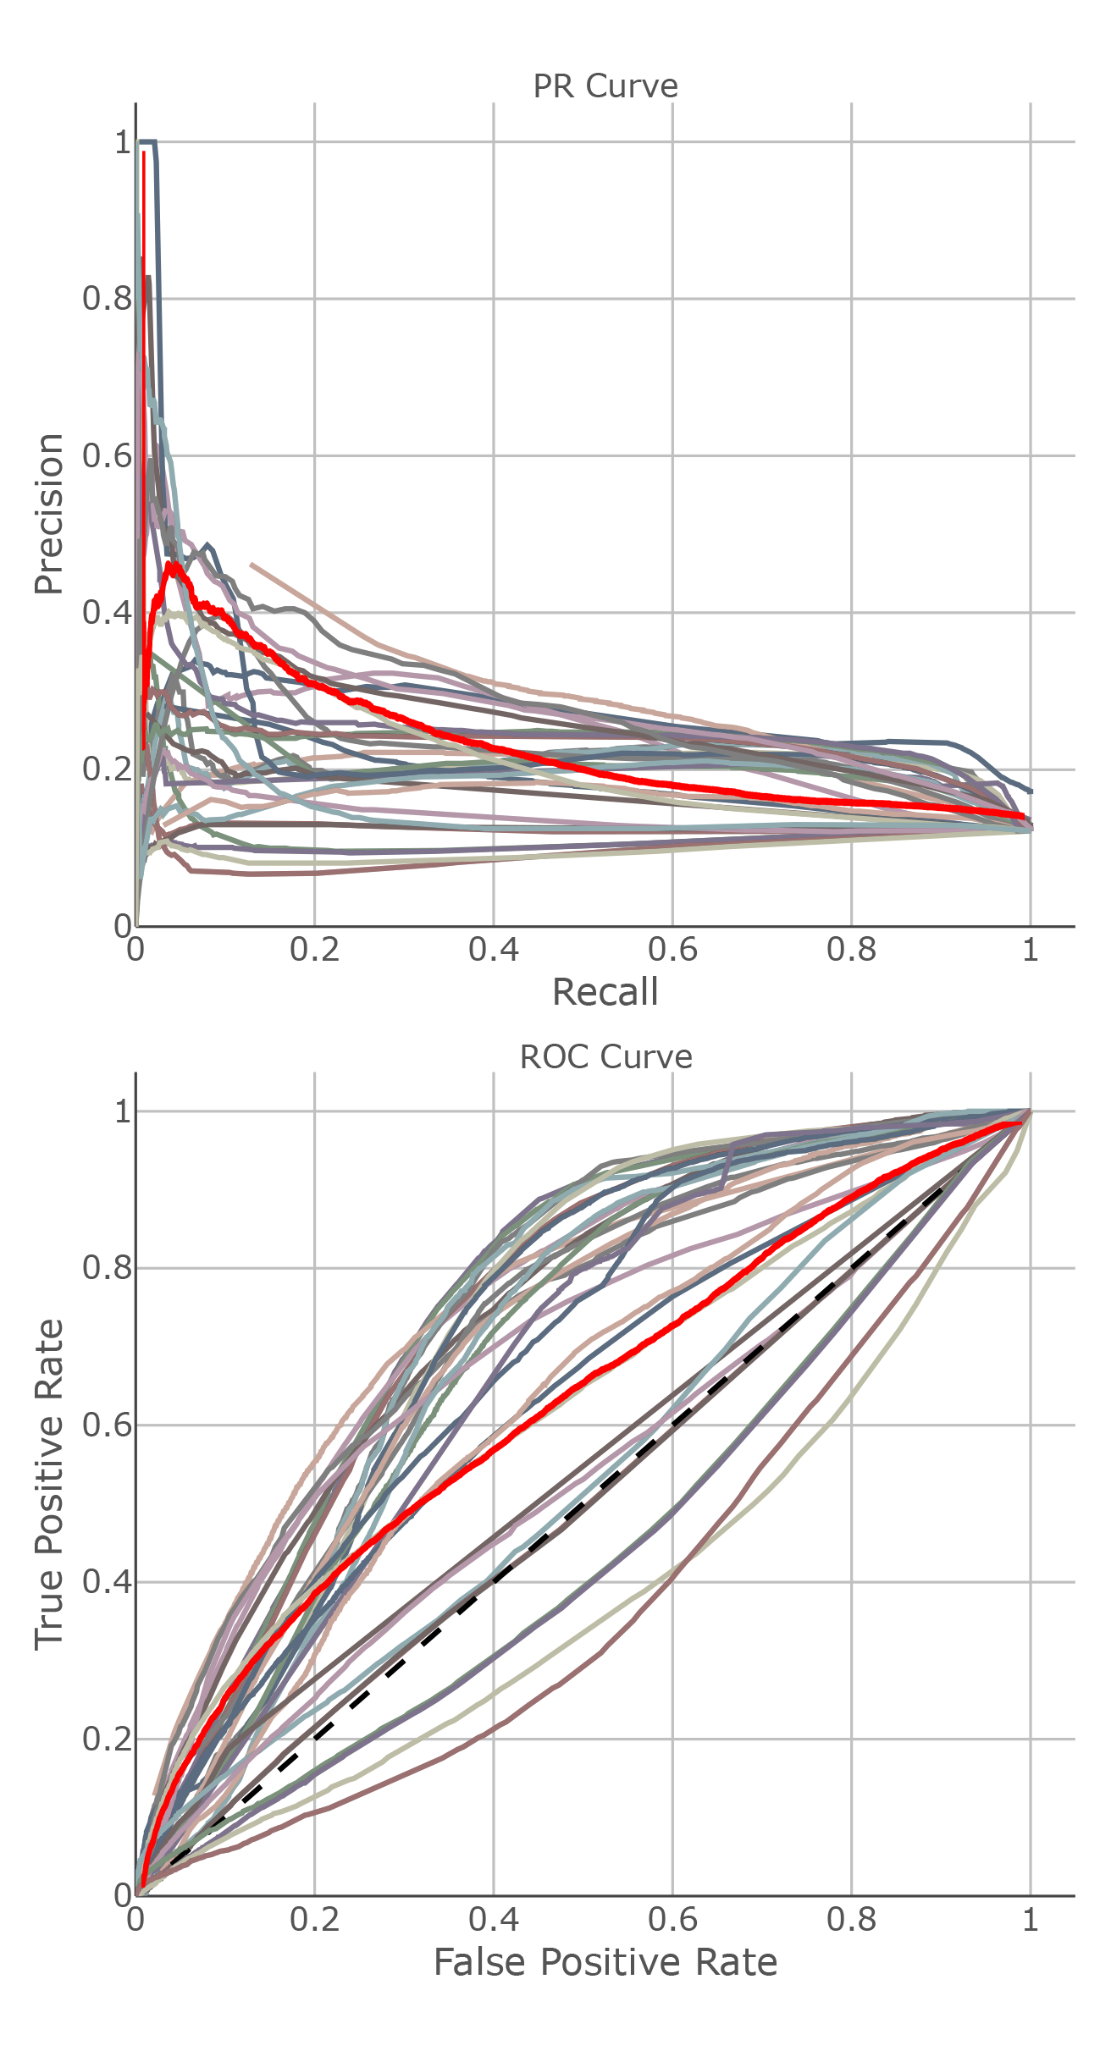
Results
CNN model comparison with other CAID models
Disorder binding prediction is a very difficult task
Relative preformances are not disappointing
The prediction problem affects other models

Slide 19
Discussion
Potential reasons:
Lack of reliable data
Problems with using PDB structures for LIPs predictions
Limits imposed by embeddings
Limits imposed by the model and the processing

Slide 20
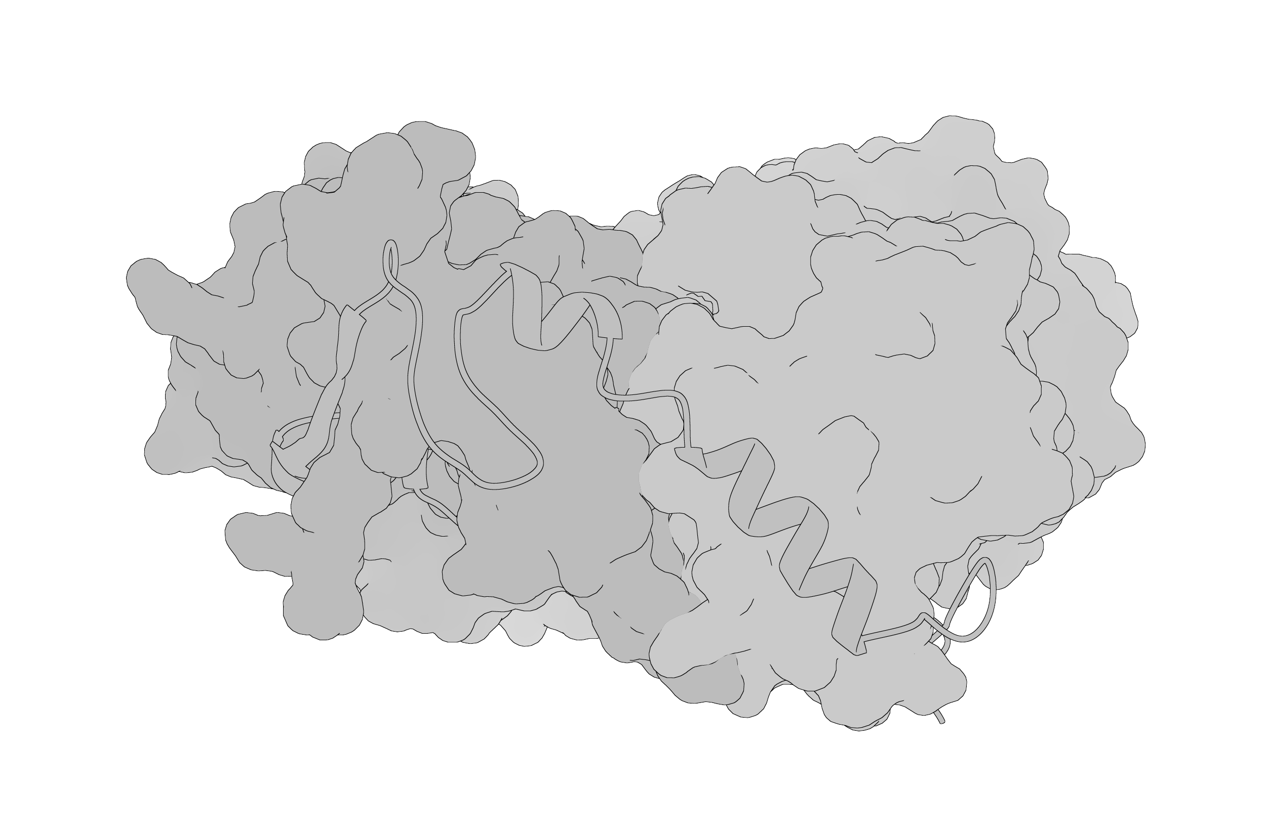
Thank you for your attention

